Slide 1
Gender Bias detection
Suyash Sethia
Jainit Bafna

Slide 2
INDEX
Introduction on gender bias
Word embedding system
Paper on WEAT (word embedding association test)
Paper on flaws of various de-biasing techniques
Paper on proposing an efficient de-biasing technique .

Slide 3

Gender and Sex
Sentence :- only men can be soldiers . => biased
Sentence :- only men can be fathers . => not-biased

Slide 4

WHAT WHERE HOW ?
Gender bias in NLP tools
Machine translation
Article generation
Word embeddings

Slide 5
Papers
Measuring Gender Bias in Word Embeddings across Domains and Discovering New Gender Bias Word Categories (Kaytlin Chaloner , Alfredo Maldonado)
Understanding Undesirable Word Embedding Associations (Kawin Ethayarajh, David Duvenaud† , Graeme Hirst)
Lipstick on a Pig: Debiasing Methods Cover up Systematic Gender Biases in Word Embeddings But do not Remove Them (Hila Gonen1 and Yoav Goldberg1,2 )

Slide 6


Slide 7
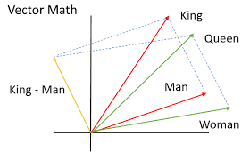
Word embedding system
The most important feature of word embeddings is that similar words in a semantic sense have a smaller distance (either Euclidean, cosine or other)
“Ped” and tree will have almost the same word
Embedding despite being in different languages
due to sense similarity

Slide 8
How Word Embeddings are Created
Read the text

Slide 9
How Word Embeddings are Created
Read the text
Preprocess text

Slide 10
How Word Embeddings are Created
Read the text
Preprocess text
Create (x,y) data points

Slide 11
How Word Embeddings are Created
Read the text
Preprocess text
Create (x,y) data points
Create one hot encoded (X,Y) matrices

Slide 12
How Word Embeddings are Created
Read the text
Preprocess text
Create (x,y) data points
Create one hot encoded (X,Y) matrices
Train a neural network

Slide 13
How Word Embeddings are Created
Read the text
Preprocess text
Create (x,y) data points
Create one hot encoded (X,Y) matrices
Train a neural network
Extract the weights from the input layer

Slide 14
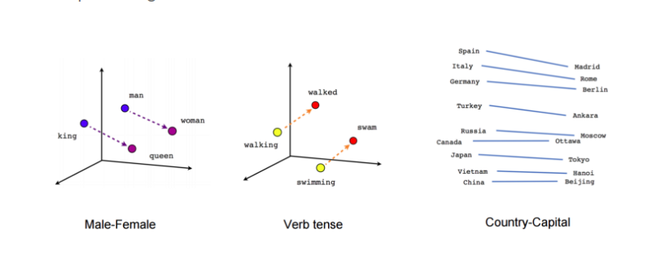
How Word Embeddings are Created

Slide 15
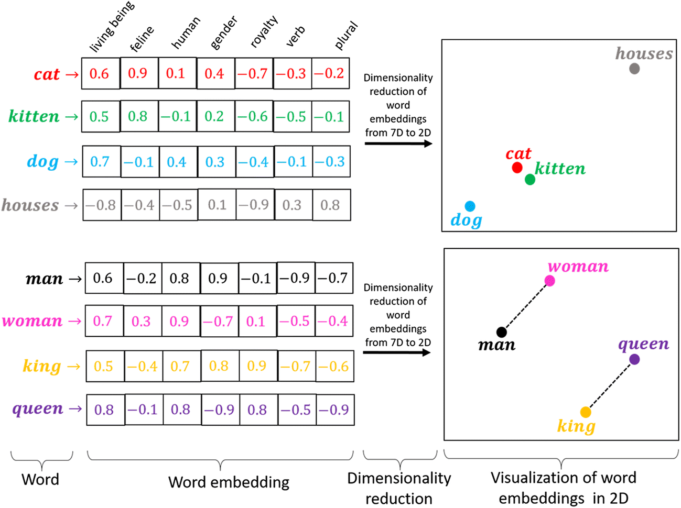

Slide 16
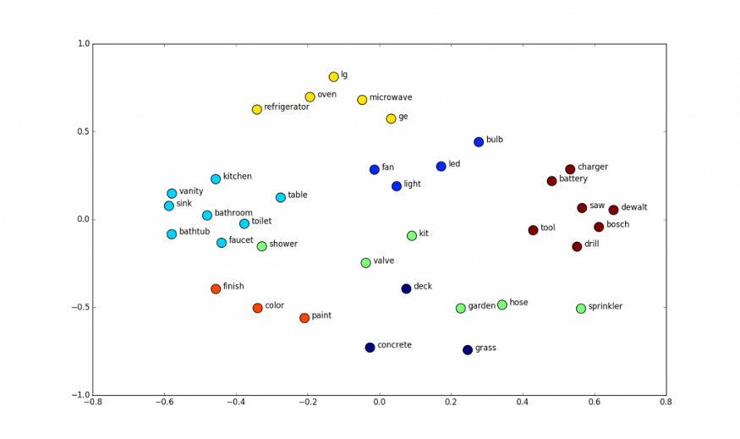
Vector space

Slide 17
Choice of word embeddings
Skip-Gram embed-dings trained on the Google News corpus2 , with
a vocabulary of 3M word types (Mikolov et al.,2013)
Skip-Gram embeddings trained on 400 million Twitter micro-posts3 , with a vocabulary of slightly more than 3M word types (Godin et al.2015)
Skip-Gram embeddings trained on the PubMed Central Open Access subset (PMC) and PubMed4 , with a vocabulary of about 2.2M word types (Chiu et al., 2016) and trained using two dif- ferent sliding window sizes: 2 and 30 words;

Slide 18
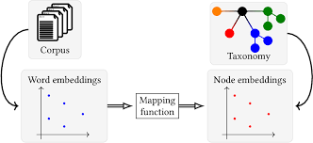
Embeddings represent the corpus

Slide 19
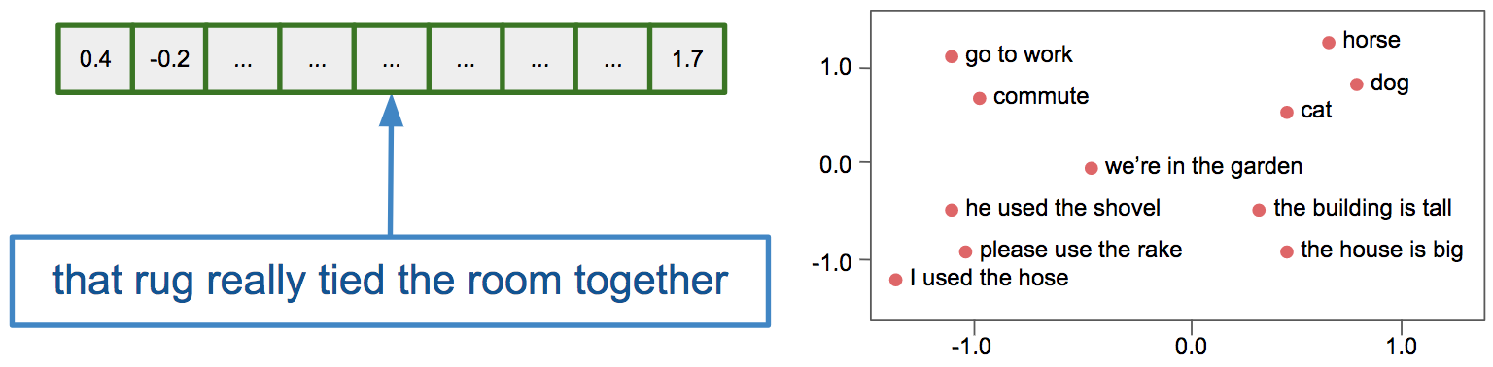
WEAT (word embedding association test )
E.g. X = {programmer, engineer, scientist}, Y = {nurse, teacher, librarian}.
M = {man, male, he}, F = {woman, female, she}.

Slide 20
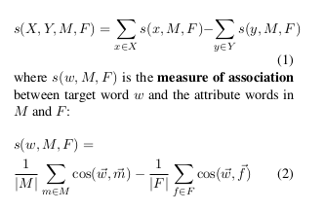
WEAT
X = {programmer, engineer, scientist}
Y = {nurse, teacher, librarian}.
Attribute Words :-
M = {man, male, he},
F = {woman, female, she}
Ho = Null hypothesis that there is no difference between X and Y in terms of their relative (cosine) similarity to M and F

Slide 21
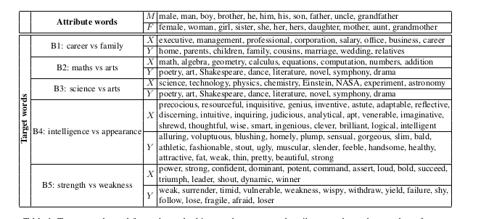

Slide 22
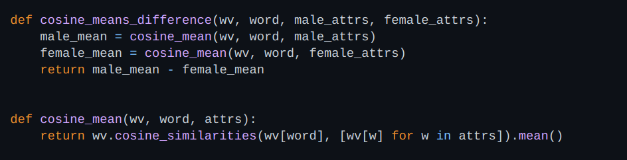
Code snippets

Slide 23
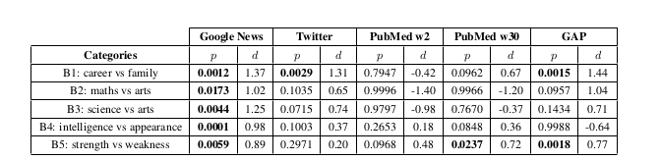
Results

Slide 24
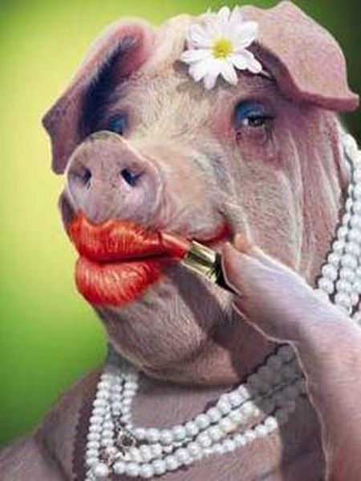
Lipstick on a pig

Slide 25
Lipstick on a pig
Debiasing Methods Cover up Systematic Gender Biases in Word Embeddings But do not Remove Them

Slide 26
What is “Biased” According to Bolukbasi et al. ?

Slide 27
What is “Biased” According to Bolukbasi et al. ?
Bolukbasi et al. (2016b) define the gender of a word w by its projection on the “gender direction” :
w⃗.(he⃗ - she⃗) , assuming all vectors are normalised.

Slide 28
What is “Biased” According to Bolukbasi et al. ?
Bolukbasi et al. (2016b) define the gender of a word w by its projection on the “gender direction” :
w⃗.(he⃗ - she⃗) , assuming all vectors are normalised.
The larger a word’s projection is on he − she, the more biased it is. They also quantify the bias in word embeddings using this definition and show that it aligns well with social stereotypes

Slide 29
Debiasing method by
Bolukbasi et al. (2016b)

Slide 30
Bolukbasi et al. ‘s method
It was a post-processing method

Slide 31
Bolukbasi et al. ‘s method
It was a post-processing method
Given a word embedding matrix, they make changes to the word vectors in order to reduce the gender bias as much as possible for all words that are not inherently gendered (e.g. mother, brother, queen).

Slide 32
Bolukbasi et al. ‘s method
It was a post-processing method
Given a word embedding matrix, they make changes to the word vectors in order to reduce the gender bias as much as possible for all words that are not inherently gendered (e.g. mother, brother, queen).
They do that by zeroing the gender projection of each word on a predefined gender direction.

Slide 33
Bolukbasi et al. ‘s method
It was a post-processing method
Given a word embedding matrix, they make changes to the word vectors in order to reduce the gender bias as much as possible for all words that are not inherently gendered (e.g. mother, brother, queen).
They do that by zeroing the gender projection of each word on a predefined gender direction.
However, as we show in this work, while the gender-direction is a great indicator of bias, it is only an indicator and not the complete manifestation of this bias

Slide 34
Debiasing method by
Bolukbasi et al. (2016b)
Zhao et al. (2018)

Slide 35
Zhao el al. ‘s method
Took a different approach and suggested to train debiased word embeddings from scratch.

Slide 36
Zhao el al. ‘s method
Take a different approach and suggest to train debiased word embeddings from scratch.
Instead of debiasing existing word vectors, they alter the loss of the GloVe model , aiming to concentrate most of the gender information in the last coordinate of each vector.

Slide 37
Zhao el al. ‘s method
Take a different approach and suggest to train debiased word embeddings from scratch.
Instead of debiasing existing word vectors, they alter the loss of the GloVe model , aiming to concentrate most of the gender information in the last coordinate of each vector.
This way, one can later use the word representations excluding the gender coordinate.

Slide 38
Zhao el al. ‘s method
Take a different approach and suggest to train debiased word embeddings from scratch.
Instead of debiasing existing word vectors, they alter the loss of the GloVe model , aiming to concentrate most of the gender information in the last coordinate of each vector.
This way, one can later use the word representations excluding the gender coordinate.
They do that by using two groups of male/female seed words, and encouraging words that belong to different groups to differ in their last coordinate.

Slide 39
Remaining bias after using debiasing methods
Word similarity is still same
The definition of biasness is not essentially correct ie it is very naive .
Just the vector projection on (man vector - woman vector ) is removed which does not account for complete de-bias .

Slide 40
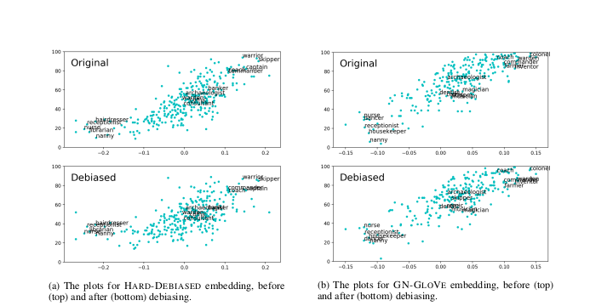

Slide 41
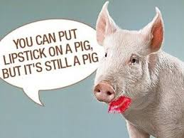
Conclusion

Slide 42
Research questions
Our focus is on mainly three questions
Does debiasing via subspace projection method provably debias embeddings ?
Why should WEAT be used to measure word associations ?
What's to blame , why we still have gender bias in data , is the word embedding model , training data ?

Slide 43
Defining unbiasedness
Let M be the word-context matrix the embedding model implicitly factorizes WCᵀ = M
Word w unbiased in M wrt word pairs S iff
∀(x,y) ∈ S , Mw,x = Mw,y
E.g., ‘doctor; unbiased wrt {(‘king’, ‘queen’)} iff
Mdoctor , king = Mdoctor, queen

Slide 44
Lipstick on a pig
If we define a bias subspace using S and use it to debias ‘w’, we can only say definitively that w is unbiased with respect to S . where S contains {‘male’, ‘female’}

Slide 45
Lipstick on a pig
If we define a bias subspace using S and use it to debias ‘w’, we can only say definitively that w is unbiased with respect to S . where S contains {‘ma⃗le’, ‘fema⃗le’}
We cannot claim,for example, that ‘w’ is also unbiased with respect to {(‘police⃗man’, ‘policewo⃗man’)}, because it is possible that
polic⃗eman - policew⃗oman ≠ ma⃗n - wo⃗man

Slide 46
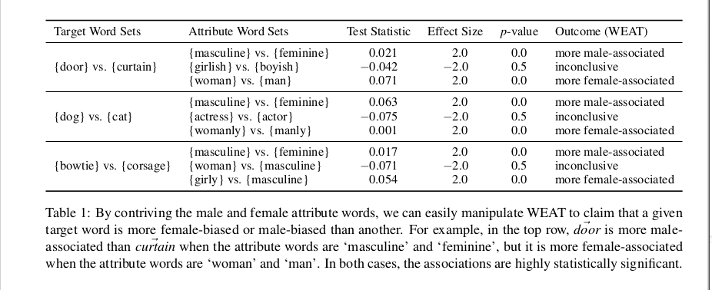
Problem with WEAT

Slide 47

New Method RIPA
RIPA stands for Relational Inner Product Association
The RIPA of a word w wrt to relational vector :
where
Word pairs S define the association (e.g. {‘king’ , ‘queen’} )
b =principal component ({x-y | (x,y) ∈ S })

Slide 48
Advantages of RIPA
Interpretable when embedding model factorizes word-context matrix

Slide 49
Advantages of RIPA
Interpretable when embedding model factorizes word-context matrix
Robust to how b is defined

Slide 50
Advantages of RIPA
Interpretable when embedding model factorizes word-context matrix
Robust to how b is defined
Derived from the subspace projection method of debiasing

Slide 51
What Cause Bias ,Training Data or Model?

Slide 52
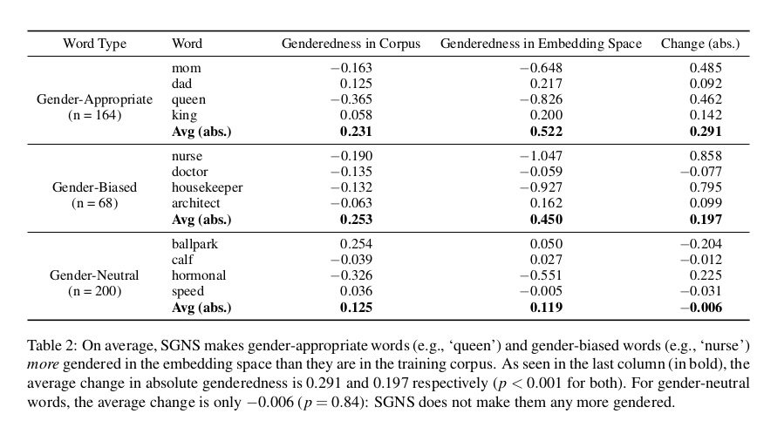

Slide 53
RIPA model is Unsupervised
So unlike the method introduced by Bolukbasi, the algorithm automatically decides which words should be debiased.

Slide 54
RIPA model is Unsupervised
So unlike the method introduced by Bolukbasi, the algorithm automatically decides which words should be debiased.
We propose an unsupervised method for finding gender-appropriate words. We first create a gender-defining relation vector b∗ by taking the first principal component of gender-defining difference vectors such as man− woman.

Slide 55
RIPA model is Unsupervised
So unlike the method introduced by Bolukbasi, the algorithm automatically decides which words should be debiased.
We propose an unsupervised method for finding gender-appropriate words. We first create a gender-defining relation vector b∗ by taking the first principal component of gender-defining difference vectors such as man− woman.
Using difference vectors from biased analogies, such as doctor - midwife we then create a bias-defining relation vector b the same way. We then debias a word w using the subspace projection method iff it satisfies |β (w;b∗ )|< |β (w;b0 )|his simple condition is sufficient to preserve almost all gender-appropriate analogies while precluding most gender-biased ones.

Slide 56
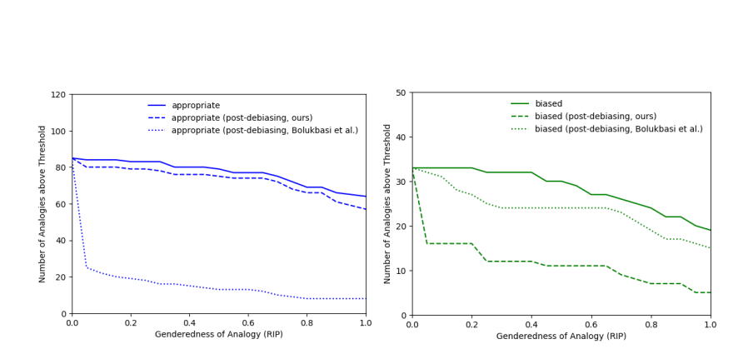

Slide 57
Biblography
Measuring Gender Bias in Word Embeddings across Domains and Discovering New Gender Bias Word Categories - Chaloner & Maldonado, 2019.
Gonen, H., & Goldberg, Y. (2019). Lipstick on a Pig: Debiasing Methods Cover up Systematic Gender Biases in Word Embeddings But do not Remove Them.
Understanding Undesirable Word Embedding Associations (Ethayarajh et al., ACL 2019)
Jieyu Zhao, Yichao Zhou, Zeyu Li, Wei Wang, and Kai- Wei Chang. 2018. Learning gender-neutral word embeddings. In Proceedings of EMNLP, pages 4847–4853.
Tolga Bolukbasi, Kai-Wei Chang, James Zou, Venkatesh Saligrama, and Adam Kalai. 2016a. Man is to computer programmer as woman is to homemaker? debiasing word embeddings.

